Slide 1
Data Structures and Algorithms
Binary Search Trees
Lecture 9:
Department of Computer Science & Technology
United International College

Slide 2
Outline
Trees
Basic Concepts
Binary Trees
Tree Traversal
Binary Search Trees
Find
Insert
Delete

Slide 3
Trees
A tree is a collection of nodes
The collection can be empty
(recursive definition) If not empty, a tree consists of a distinguished node r (the root), and zero or more nonempty subtrees T₁, T₂, ...., T_{k}, each of whose roots are connected by a directed edge from r
A
Subtree of A

Slide 4

Some Terminologies
Root and Leaf
Child and Parent
Every node except the root has one parent
A node can have an zero or more children
A leaf node has no children
Sibling
nodes with same parent
A
B
C
D
E
F
G
H
Siblings
I
J
K
L
M
O
P
Siblings

Slide 5
More Terminologies
Path
a sequence of edges
Length of a path
Depth of a node
length of the unique path to the root
Height of a node
length of the longest path to a leaf
Tree height
the height of the root
the depth of the deepest leaf
Ancestor and descendant
If there is a path from n1 to n2
n1 is an ancestor of n2, n2 is a descendant of n1
Proper ancestor and proper descendant
A
B
C
E
F
G
H
I
J
K
L
M
O
P
D
Length of the blue path = 4
Depth(B) = 1
Height(B) = 3
B is D's Ancestor
D is B's Descendant

Slide 6
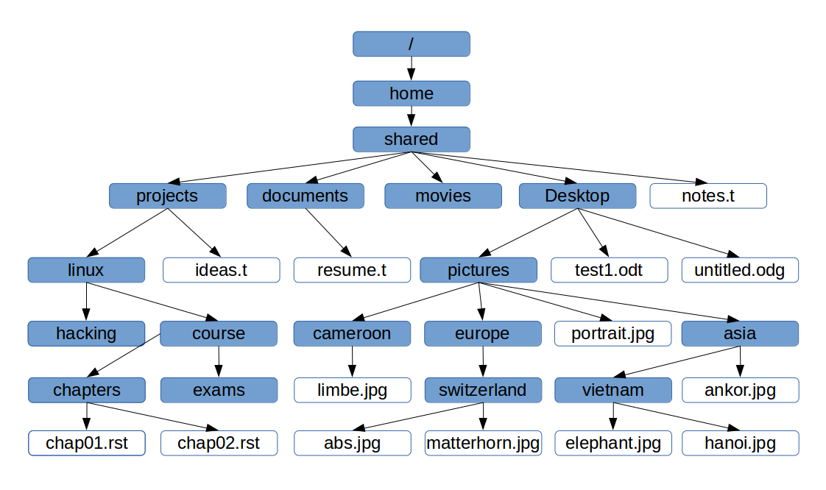
Example: UNIX Directory

Slide 7
Example: Expression Trees
+
Leaves are operands (constants or variables)
The internal nodes contain operators
Will not be a binary tree if some operators are not binary
+
*
a
*
+
g
b
c
*
f
d
e
Expression tree for: (a + b*c) + (d*e + f) * g

Slide 8
Binary Trees
A tree in which no node can have more than two children
The depth of an “average” binary tree is considerably smaller than N, even though in the worst case, the depth can be as large as N – 1.
root
Generic binary tree
T_{Left}
T_{Right}
2
3
Worst-case binary tree
4
5
6

Slide 9
Binary Tree Traversal
Three strategies for tree nodes enumeration
Pre-order traversal
Recursive algorithm
First visit the root, then the left subtree, then the right
In-order traversal
Recursive algorithm
First visit the left subtree, then the root, then the right subtree
Post-order traversal
Recursive algorithm
First visit the left subtree, then the right, then the root

Slide 10
Pre-order Traversal
node, left, right
prefix expression
++a*bc*+*defg
+
+
*
a
*
+
g
b
c
*
f
d
e
Expression tree for: (a + b*c) + (d*e + f) * g

Slide 11
Post-order Traversal
left, right, node
postfix expression
abc*+de*f+g*+
+
+
*
a
*
+
g
In-order Traversal
left, node, right
infix expression
a+b*c+d*e+f*g
b
c
*
f
d
e
Expression tree for: (a + b*c) + (d*e + f) * g

Slide 12
Pseudo Code for Pre-order, In-order and Post-order
PREORDER(root)
1. IF root = Null 2. return 3. PRINT(root)
4. PREORDER(LEFT(root)) 5. PREORDER(RIGHT(root))
INORDER(root)
1. IF root = Null 2. return
3. INORDER(LEFT(root)) 4. PRINT(root) 5. INORDER(RIGHT(root))
POSTORDER(root)
1. IF root = Null 2. return 3. POSTORDER(LEFT(root)) 4. POSTORDER(RIGHT(root)) 5. PRINT(root)

Slide 13
Node Struct of Binary Tree
Possible operations on the Binary Tree ADT
Parent, left, right, sibling, root, etc
Implementation
Because a binary tree has at most two children, we can keep direct pointers to them
Node
data: Object left: Node right: Node
+ Node() + …

Slide 14
Binary search trees
A binary tree which offers directed search

Slide 15
Binary Search Trees (BST)
Binary search tree property:
For every node X:
All the keys in its left subtree are smaller than the key value in X
All the keys in its right subtree are larger than the key value in X
Pre-assumption
Objects are stored in tree nodes
Book information: ISBN, Title, author, abstract, price, …
The keys of the objects are used for search and comparison
ISBN
x
For any node y in this subtree key(y)<key(x)
For any node z in this subtree key(z)>key(x)
No Duplicates!

Slide 16
OBJECTS with keys
For easy demonstration, we store just integer keys in the tree nodes, but be noted that in practice, it is usually
that are stored and are later inserted, deleted and searched.

Slide 17
Binary Search Tree Example
6
6
2
8
2
8
1
4
1
4
3
3
7
A binary search tree
Not a binary search tree
WHY?

Slide 18
Binary Search Trees
The same set of keys may have different BSTs
2
5
3
3
7
4
5
2
4
8
7
8
The order of node insertion affects the shape of the tree
Maximum depth of a node is n-1

Slide 19
In-order Traversal of BST
15
6
18
3
7
17
20
2
4
13
9
14
2, 3, 4, 6, 7, 9, 13, 14, 15, 17, 18, 20
A sorted list!

Slide 20
Operations on Binary Search Trees
Search
FindMin / FindMax
Insert
Delete

Slide 21
Searching BST
The current root is 15
If we are searching for 15, then we are done.
If we are searching for a key < 15, then we should search in the left subtree.
If we are searching for a key > 15, then we should search in the right subtree.
15
root
<15
>15

Slide 22
Directed Search
Search for 9:
Compare 9:15, go left
Compare 9:6, go right
Compare 9:7, go right
Compare 9:13, go left
Compare 9:9, found it!
15
6
18
3
7
17
20
2
4
13
9
14

Slide 23
Pseudo Code for Search
FIND(root, x)
Searches the subtree rooted at root
Returns a pointer to the node whose key is x
Returns Null if no such node exists
Time complexity: O(tree height)
FIND(root, x)
IF root=Null
return Null
IF root.key=x
return root
IF root.key>x
return FIND(root.left, x)
return FIND(root.right, x)

Slide 24
findMin / findMax
Goal: return the node containing the smallest (largest) key in the tree
Algorithm: Start at the root and go left (right) as long as there is a left (right) child. The stopping point is the smallest (largest) element
Time complexity: O(tree height)
FIND-MIN(root)
IF root=Null
return Null
IF root.left=Null
return root
return FIND-MIN(root.left)
FIND-MAX(root)
IF root=Null
return Null
IF root.right=Null
return root
return FIND-MAX(root.right)

Slide 25
Insertion
Insert(root, x)
Proceed down the tree as you would with a find
If x is found, do nothing (reject duplicates)
Otherwise, insert x at the last spot on the path traversed
Time complexity = O(tree height)
15
6
18
3
7
17
20
2
4
13
14
Insert(root, 14)

Slide 26
Pseudo Code for Insertion
INSERT(root, x)
// returns the (updated) root of the subtree
IF root=Null
return CREATE-NODE(x)
IF x<root.key
root.left = INSERT(root.left, x)
ELSE IF x>root.key
root.right = INSERT(root.right, x)
return root

Slide 27

Deletion
When we delete a node, we need to consider how we take care of the children of the deleted node.
This has to be done such that the property of the search tree is maintained.

Slide 28
Three Delete Cases
Case 1: the node is a leaf
Delete it immediately
6
6
3
7
3
7
2
4
13
2
4
13
9
14
9

Slide 29
Three Delete Cases
Case 2: the node has one child
Adjust a pointer from the parent to bypass that node
6
6
3
7
3
13
2
4
13
2
4
9
14
9
14

Slide 30
Three Delete Cases
Case 3: the node has two children
Replace that node with the minimum node in the right subtree
Or replace it with the maximum node in the left subtree
This invokes removal of the minimum node
It’s case 1 or 2. WHY?
Time complexity = O(tree height)
6
6
7
3
9
3
9
3
9
2
7
13
2
7
13
2
8
13
8
14
8
14
14

Slide 31
Pseudo Code?

Slide 32
The cost of search, insert and delete are all bounded by the Tree height which is O(n) in the worst case. And O(n) is
not fast enough!

Slide 33
Task
Given Node.java, BinaryTreePrinter.java and the skeleton of BST.java, complete BST.java
Node.java: implements the class for a BST node
BinaryTreePrinter.java : implements a method to print out a binary tree
BST.java: implements the methods defined in the BST data structure
Read the skeleton and complete all the methods
This is the only file that you are going to modify
You may add auxiliary functions if there is a need
a main function is provided for testing purpose
Submit BST.java to iSpace.

